Slide 1
Visualisation of data
U4 – Measure
E2 – Statistics
The element ‘Statistics’ reviews the basics of statistics such as mean, deviation and probability. This element reviews a range of graphs that can be used to visualize data as well.
Yellow Belt
Notes:
Welcome to this Lean Six Sigma Academy Yellow Belt training module.

Slide 2
Visualisation of Data
Graphical analysis
Graphs visualise the data
Graphs help to understand the nature of variation
Graphs help to separate signal from noise
Notes:
When we start with graphical analysis, the main objective is first to visualize the data. This helps us understand the nature of variation and separate the signal from the noise. It is difficult to draw accurate conclusions from statistical information alone.

Slide 3
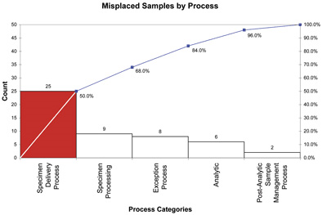
Visualisation of Data
Pareto chart
A Pareto chart is a type of bar chart with:
A horizontal axis that represents the relevant categories (usually defects or errors)
Bars that are ordered from largest to smallest value to identify the “obvious many“ and the “vital few”
A cumulative percentage line that shows the cumulative contribution
80-20 rule
80% of the problems are caused by 20% of the factors
A Pareto chart can help us to focus!
Notes:
The Pareto chart is a special type of bar chart. Here, the different bars are sorted by their frequency. The most frequent issue is placed on the left and the other bars then are placed in descending order. The “Other” category is placed in the position furthest to the right, even if the frequency is higher than the adjacent issues. In the graph, we can also see the cumulative frequency of the flaws as represented by the red line. Under the graph, we can see the percentage per issue and the cumulative percentage. The Pareto chart is named after the Italian economist Vilfredo Pareto, who observed that 80% of the land in Italy was owned by only 20% of the population. This principle is called the 80 -20 Rule, which is also a good approximation in other situations. For this reason Joseph Juran applied the 80 – 20 Rule to quality management. His advice was to focus on the vital few rather than the obvious many.

Slide 4
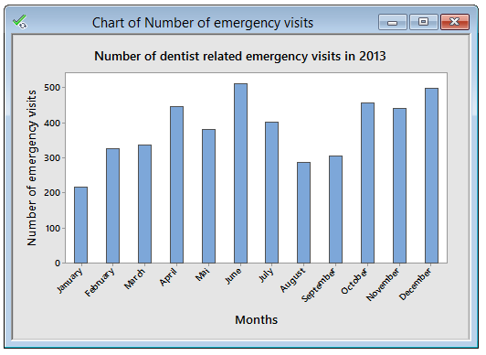

Visualisation of Data
Count results by category - Bar chart
Use a Bar chart or a Pie chart to graphically compare count results or frequencies for two or more groups
Example: Bar chart of dentist related emergency department visits
Notes:
The first graph we will discuss is the bar chart. It is used to show the measurement results by category. It is a very useful graph when you want to visualise attribute data. Bar charts show the count result or the frequency for two or more groups. In this example, the number of dentist related emergency visits are graphed by month. The height of each bar reflects the frequency or count of the visits in that particular month.
It is clear from the graph that the most number of visits is consistently high with a peak in June.

Slide 5
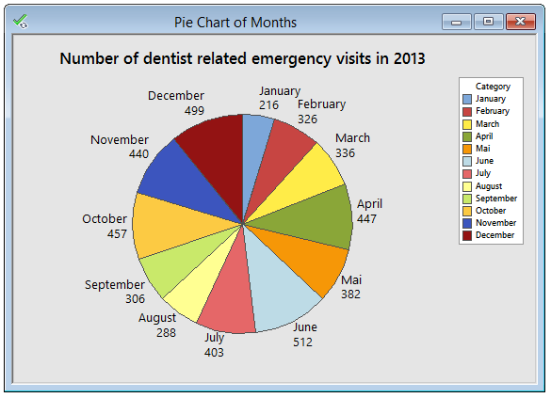
Visualisation of Data
Count results by category - Pie chart
Use a Bar chart or a Pie chart to graphically compare count results or frequencies for two or more groups
Example: Pie chart of dentist related emergency department visits
Notes:
Another way to visualise this type of data is to use a Pie Chart. Here, the number of visits each month is shown as a slice of the Pie. The size of the slice represents the frequency of the visits as compared to the total number of visits. In this case, June again is showing 512 visits a yearly high with January having the lowest number of visits. The use of colours makes the Pie Chart easy to understand.

Slide 6
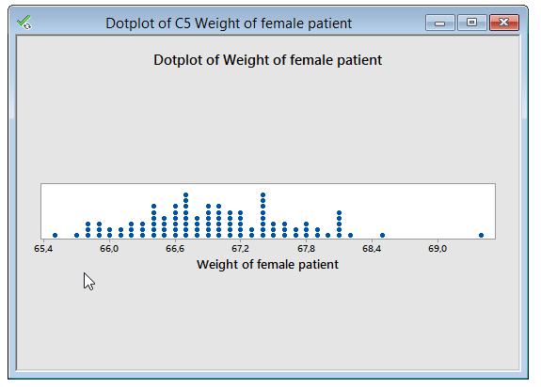
Visualisation of Data
Count results by interval - Dot plot
Visualises the distribution/dispersion of data
Example: Dotplot of patient Weight
Notes:
Here a dotplot is used to visualise the distrbution and dispersion of data. For example female patient weight is shown on this dotplot and it can be seen it varies from 65.4 up to 70.0

Slide 7
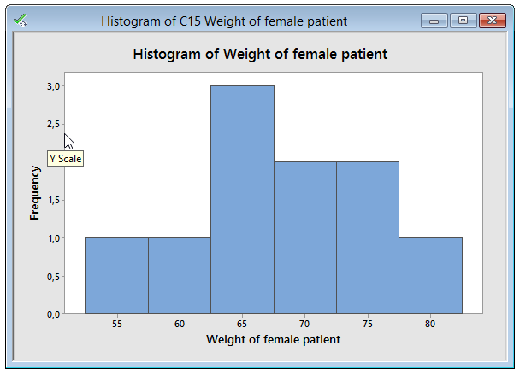
Visualisation of Data
Count results by interval - Histogram
Visualises the distribution/dispersion of data
Frequency: bars indicate the number of observations
Density: bars indicate the percentage
Example: Histogram of female patient weight
Notes:
A histogram is another method of visually demonstrating the dispersion of data eg female patient weight. The frequency bar indicates the number of patients with that weight and the bars indicate the weight in kg.

Slide 8
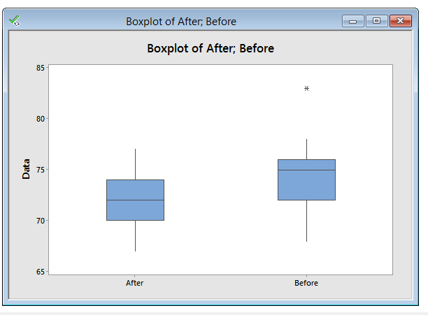
Visualisation of Data
Box plot
Use the Box plot (box-and-whisker plots) to visualise and compare data distributions
Outlier
Upper limit
Upper quartile
Median
Lower quartile
Lower limit
Notes:
The box plot is a simplified representation that shows the median and the spread of data in a very clear and visual way. This enables easy comparison between two or more distributions of data. It also allows you to easily identify the minimum and maximum values in the dataset. The box of the boxplot represents 50% of all data points. The whiskers show the distribution of the upper and lower 25% of the data. The star is indicative of a data point that lies outside the expected normal spread.

Slide 9
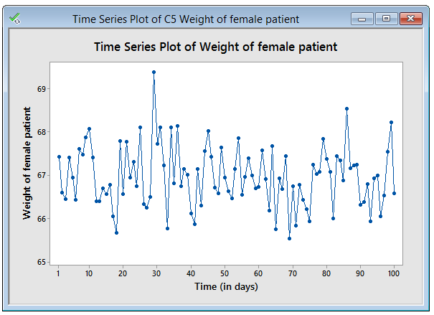
Visualisation of Data
Time series plot
Use the Time series plot to visualise and/ or discover patterns in time
Usually one of the first graphs made to see if the behaviour is stable
Example: Time series plot of patient body weight
Notes:
The next slide shows a time series plot. This graph is used to plot continuous data. In this graph all of the observations are placed in order according to the moment the measurement took place. This makes it possible to visualise and discover patterns which occur in time. This chart is also a good first tool to use to see if a certain process is stable over time. In this example, the graph shows measurements of patient weight over time which are numbered from 1 to 100 in order of the measurement time.

Slide 10
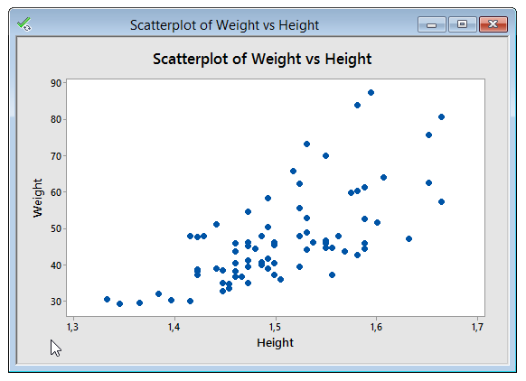
Visualisation of Data
Scatter Plot
Used to examine the relationship between two continuous variables by drawing them on separate axes
Example: Scatter plot height and weight
Notes:
The scatter plot is used to study the relationship between two continuous variables. This is done by drawing each variable on a different axis. In the graph we can see the relation between initial weight and height. If the different measurements appear in a line, it means that there is a very clear relation, also called a correlation. The more the measurements on the graph look like a cloud of points, the lesser the chance of relation or correlation.

Slide 11
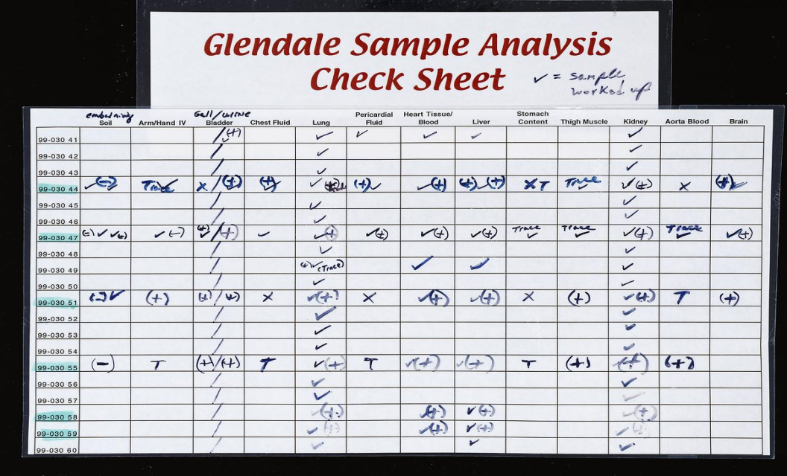
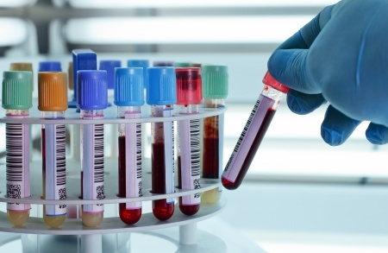
Visualisation of Data
Check sheet
A simple way to collect and analyse data (how frequently something occurs)
Indicates where problems occur - location, type, cause, etc.
123RF Stock Photo
Notes:
A check sheet is a good visual tool to collect data about a process.

Slide 12
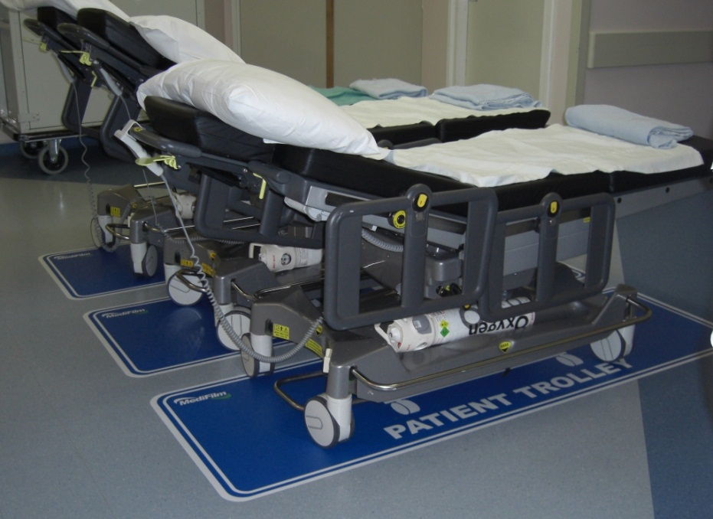
Visual Management
Visual management
Ideal tool for collaborating, achieving results and preventing problems
Oversee situation quickly
What are the results?
What goes well?
What goes wrong?
What has been done?
What needs to be done?
Are there delays?
Notes:
Visual management is used in the work environment to improve cooperation and results and to be able to prevent problems. By creating and maintaining a clean visual environment, everyone on the shop floor is able to quickly determine and understand the situation at any given time. This means that in terms of the results, everyone within the area is able to determine if there’s anything not right and if so, what actions need to be taken.

Slide 13
Visual Management
Visual management is…
Making visible (desired and undesired)
Sharing information
For a defined group of people
Reinforcing cooperation
About improvement, not about guilt
Sense of ownership
Clear and standardised working methods
Notes:
Visual management is a technique we use to make information visual and to share certain information. To be effective, this technique should be used in the correct area, meaning where the specific information is needed and useful. Only if operators are able to influence the performance parameters, should these indicators be made visual. This should create a sense of ownership within the operators in the area involved. The working methods should also be clear, standardized and available on the shop floor. When problems occur, be careful not to blame individuals, instead- reinforce cooperation and improvement.

Slide 14
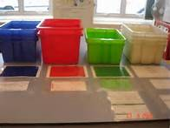
Visual Management
Visual management includes
An organised working environment (5S programs, Labelling, etc.)
Visualise goals, targets and performance criteria (planning boards)
Standardised and clear working instructions
Control work in progress (Kanban)
Autonomous maintenance
Failure prevention (Poka Yoke)
Notes:
Visual management is all about an organized working environment, which is usually achieved using 5S techniques. But visual management also includes signs and boards that visualize goals, targets and performance criteria. In addition, visual management includes working instructions and work-in-progress controls using Kanban techniques or planning boards. First line maintenance is also important here as well as failure prevention through Poka Yoke techniques.

Slide 15
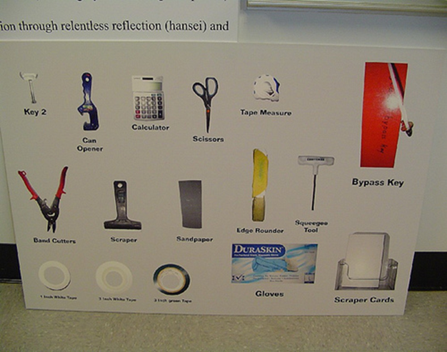
Visual Management
Visual management basic principles
Providing information
Which is related to a department
Which can be influenced by the department
Initiating improvements
Visualise goals and performances and discuss them
Correct quickly deviations (PDCA)
Notes:
The two basic principles of visual management are: providing information that is related to the department concerned, and showing information that can be influenced by the department. Simply showing information however is not enough - the goal is to stimulate improvements. This can be achieved by regularly discussing performance and problems. By using the Plan, Do, Check, Act cycle we can quickly correct any deviations. In this way, shop floor personnel become more motivated to participate in these initiatives.

Slide 16
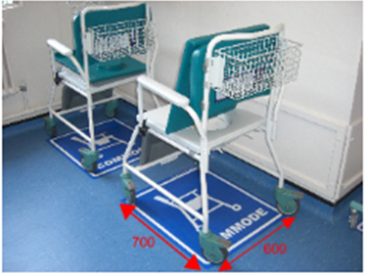
Visual Management
Example of organised workplace (5S & labelling)
Orderliness and cleanliness provides insight and overview
Notes:
Here we can see an example of an organized workplace in a production environment. A regularly maintained clean floor is important. Lines on the floor mark the placement of equipment and storage space, as well as areas for desks and racks. In general, there should be a place where meetings can take place and information should be provided on publication boards.

Slide 17
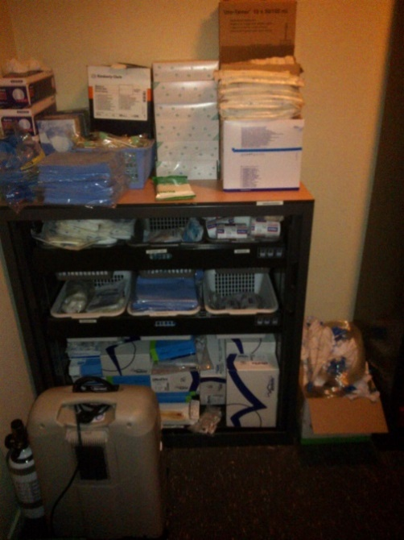
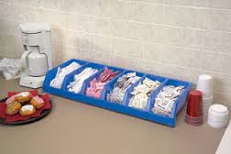
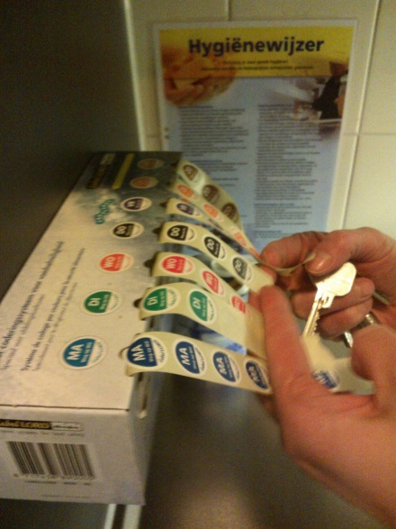
Visual Management
Examples of organised workplace (5S & labeling)
Notes:
Here are some more examples of organized workspaces. It is important that those working in the area are able to quickly find what they need to do their work. It is therefore important to use visual systems and good labeling. Remember that only what is used on a daily basis is needed on the desk. We should also be able to immediately identify if something is missing and what exactly it is that is missing.

Slide 18
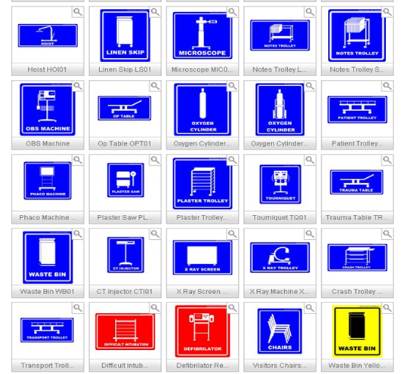
Visual Management
Example of Standardisation
Standard symbols
Notes:
Another example of standardization is the use of standard symbols and labels or signs. Using correct signs helps identify where something is located or if it is missing from its locations. Signs help quickly identify any missing tools. You should also be sure to mark the standard location of the trolleys on the shop floor and clearly indicate where they should be placed when not in use.

Slide 19
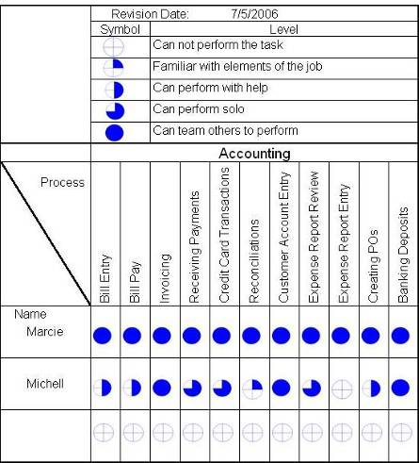

Visual Management
Example of Employee skill matrix
Trained employees are essential
for good quality
Is sufficient expertise
available for a specific process?
Notes:
Many companies nowadays also maintain skill matrices within different departments. This creates a visual overview of the training needs within the specific department. It also provides a good overview of any potential problems that may occur if people are absent because of illness or vacation. Trained employees are, of course, a basic requirement for producing good quality and are important to be able to identify and remedy the root causes for problems.

Slide 20
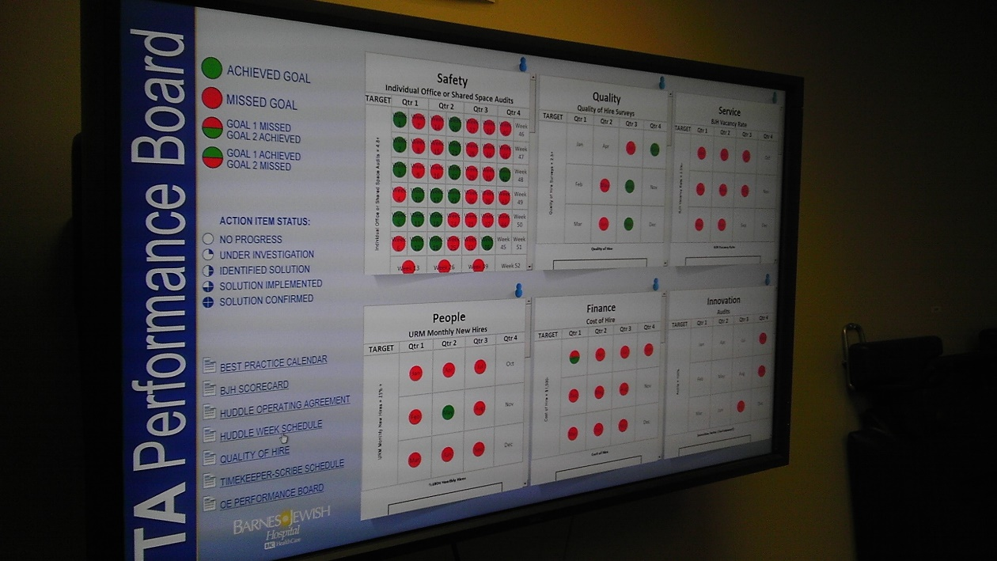
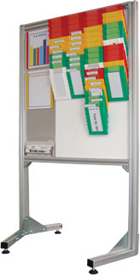
Visual Management
Examples of Visualise performance
Notes:
An integral part of improving the current process is providing feedback on the performance of the operation within the department. It is important for the performance key parameters to be identified and measured on a regular basis. All operators should understand the definitions of these key process indicators and should be able to influence them. Furthermore, regular discussions with employees concerning the performance of the department should be used to create new improvement ideas.

Slide 21
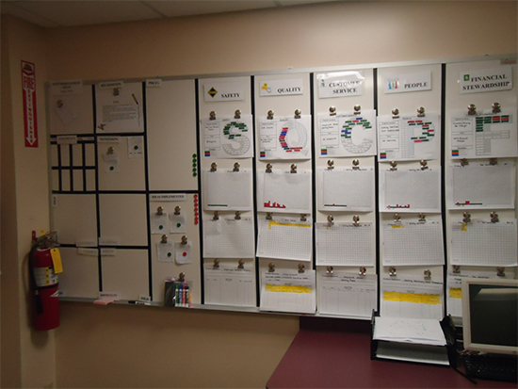
Visual Management
Example of Visualise improvement (PDCA)
Improvement board
Notes:
In addition to visually presenting the performance of the department, we should also be sure to communicate the progress of improvements. This means communicating the current Plan, Do, Check and Act cycles and other improvement projects which should be regularly updated. This is an opportunity to involve and motivate all employees to contribute to these improvements.

Slide 22
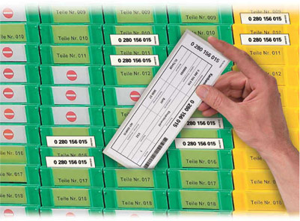
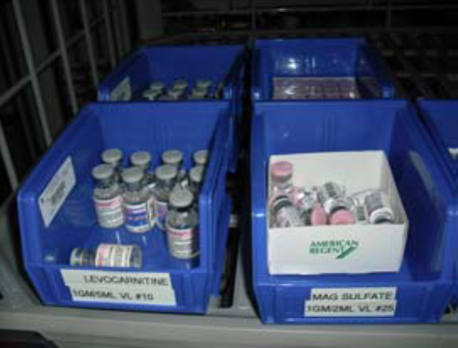
Visual Management
Examples of Visual flow
Every order is linked to a physical card (this is called ‘Kanban’ or ‘Tag’)
Medications in two bin with FIFO (first in first out) organization
Notes:
There are also opportunities to visualize departmental planning operations. We can visualize the flow of production orders through the department by using physical cards, which can be placed in different slots on the planning boards. In this way, the priority of orders is clearly visible and we can see the maximum amount of orders possible at a certain time. These cards are called Kanban cards or tags and can be used for controlling the total amount of work-in-progress within the department.

